Slide 1
DSX Local
Overview & Roadmap
July 2018
Joel Patterson
jpatter@us.ibm.com

Slide 2
DSXL Labs
https://ec2-54-88-58-154.compute-1.amazonaws.com
user01 - user20 / IBMdsxl!

Slide 3



Value of a Data Science Platform
Explore at scale
Scale out on-demand
No Dev-ops/engineering setup
Collaborate
Understand what’s been done
Share and accelerate learning
Open
Use desired tool of choice
Interoperability across tools
Reproducibility
Process of tracking
Reproduce results easily
Publish Efforts
Models as APIs out of the box
Avoid Engineering re-work
Review Results
Stakeholder review
Via Dashboards/Static reports
Secure
Governed Access
Administration capabilities
Discovery to Production
Minimal efforts
Seamless scale
Integration with business process
Monitoring
QA/QC on-demand
Retrain

Slide 4



IBM DSX - the Experience for Hybrid Data Science
Develop & Collaborate
Notebook servers and RStudio for interactivity & data visualizing with Python, R, & Scala for coder data scientists
Deploy at Scale
Spark parallelizes & accelerates data science tasks.
Automate, Deploy scoring servers at scale and monitor model health
Watson Studio on IBM Public Cloud
DSX Desktop
DSX Local on Private Cloud
PayGo consumption with as-a-service delivery, up & running in seconds
Integrated with IBM Spark-as-a-Service & Watson Machine Learning as a service for compute,
IBM Object Store & other cloud services for data,
Publish and collaborate in the cloud
Easily installed on your laptop or PC
Won’t scale beyond the hardware available on your machine
Access to RStudio, Zeppelin and Jupyter notebooks, and one small Spark worker operating locally on your machine
Load CSV data files into Data Frames
Scalable DSX cluster deployed on your private infrastructure
Dockerized containers via Kubernetes & deployable on IBM Cloud Private
DSX Local can also deploy with Hortonworks Data Platform & IIAS appliance on-premises
LDAP for user management and authentication, easy collaboration with Projects enabled by git.
Use DSX wherever it makes sense for you (or where your data is) - and you can easily collaborate on the same project across these environments
and with v1.2: SPSS Modeler for Clickers and Visual Coders
Machine Learning & Data Science

Slide 5

Introducing IBM Data Science Experience Local
IBM Data Science Experience
Community
Open Source
IBM Added Value
Find tutorials and datasets
Connect with other Data Scientists
IBM ML Hub for expert assistance
Open Source evangelism
Fork and share projects, samples
Code in Scala/Python/R/SQL
Zeppelin & Jupyter Notebooks
RStudio IDE
Anaconda distribution
Add your favorite libraries
Projects and Version Control , for dev->test->prod continuous engineering
Relational & Hadoop data sources connectivity
Machine Learning & Deep Learning - manage/monitor & deploy models
Spark-in-DSX and Remote Spark (Hadoop) as well as Python & R based Analytics, ML.
Publish notebooks and other assets, Host R Shiny Apps, schedule jobs
Compute Elasticity support, manage CPU/GPU & memory resources
Data Science Elite team

Slide 6













DSX is an Open Platform
Data Science Experience
Add your favorite libraries
Publish Open APIs for secure ML applications

Slide 7
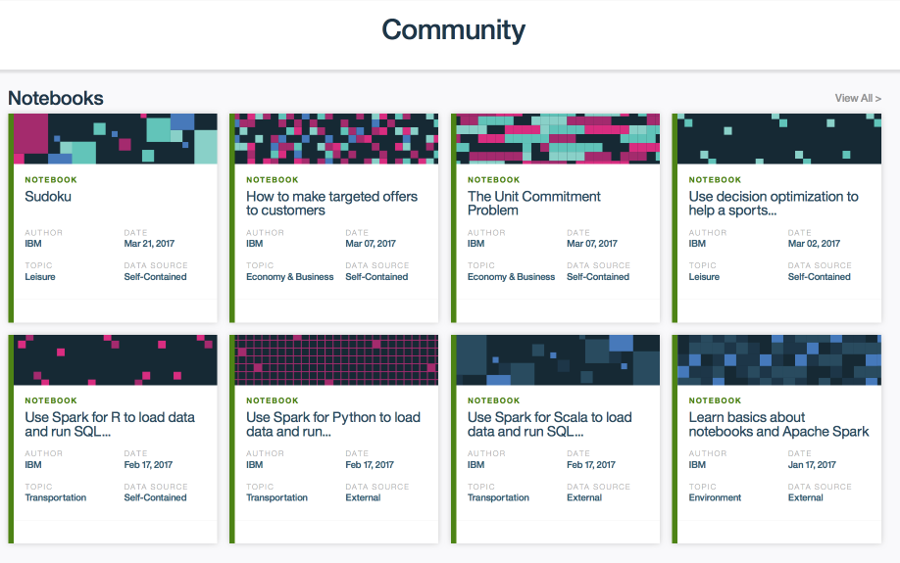
Get started easily..
Learn
Connect to Enterprise data sources easily
Collaborate
Working on cluster safer than desktops for leader
Safe behind the firewall
Big SQL, Db2 (warehouse/z/LUW), Hive for HDP, HDFS for HDP
Hive for Cloudera (CDH)
HDFS for Cloudera (CDH)
Informix, Netezza, Oracle

Slide 8
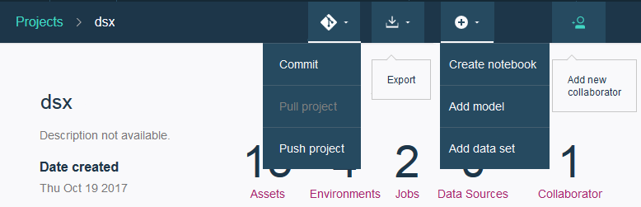
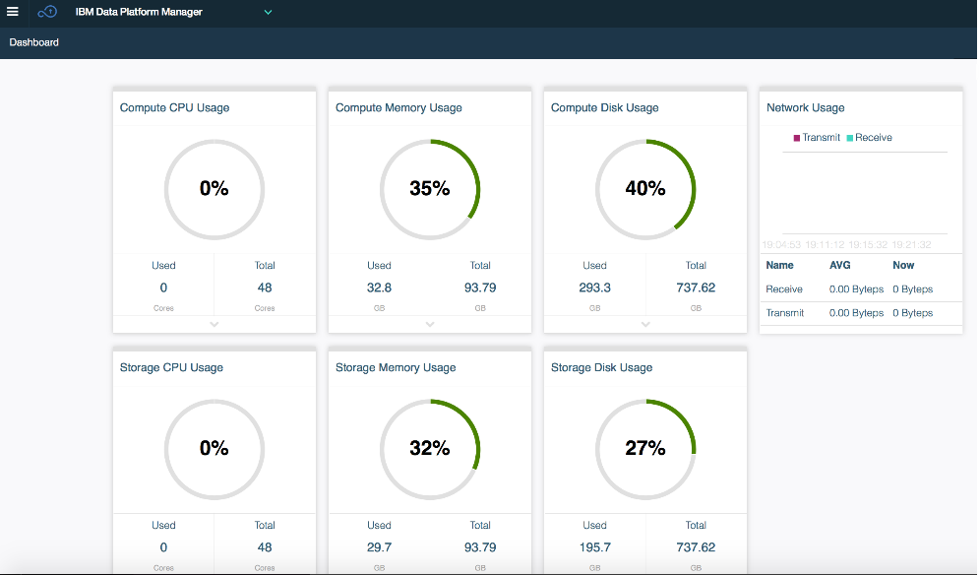
and explore
DSX Local simplifies distribution of team work based on skills
DSX Local increases knowledge sharing and knowledge retention
Currently based on open source notebooks, productivity tools in the future
DSX Local simplifies cluster management for teams

Slide 9
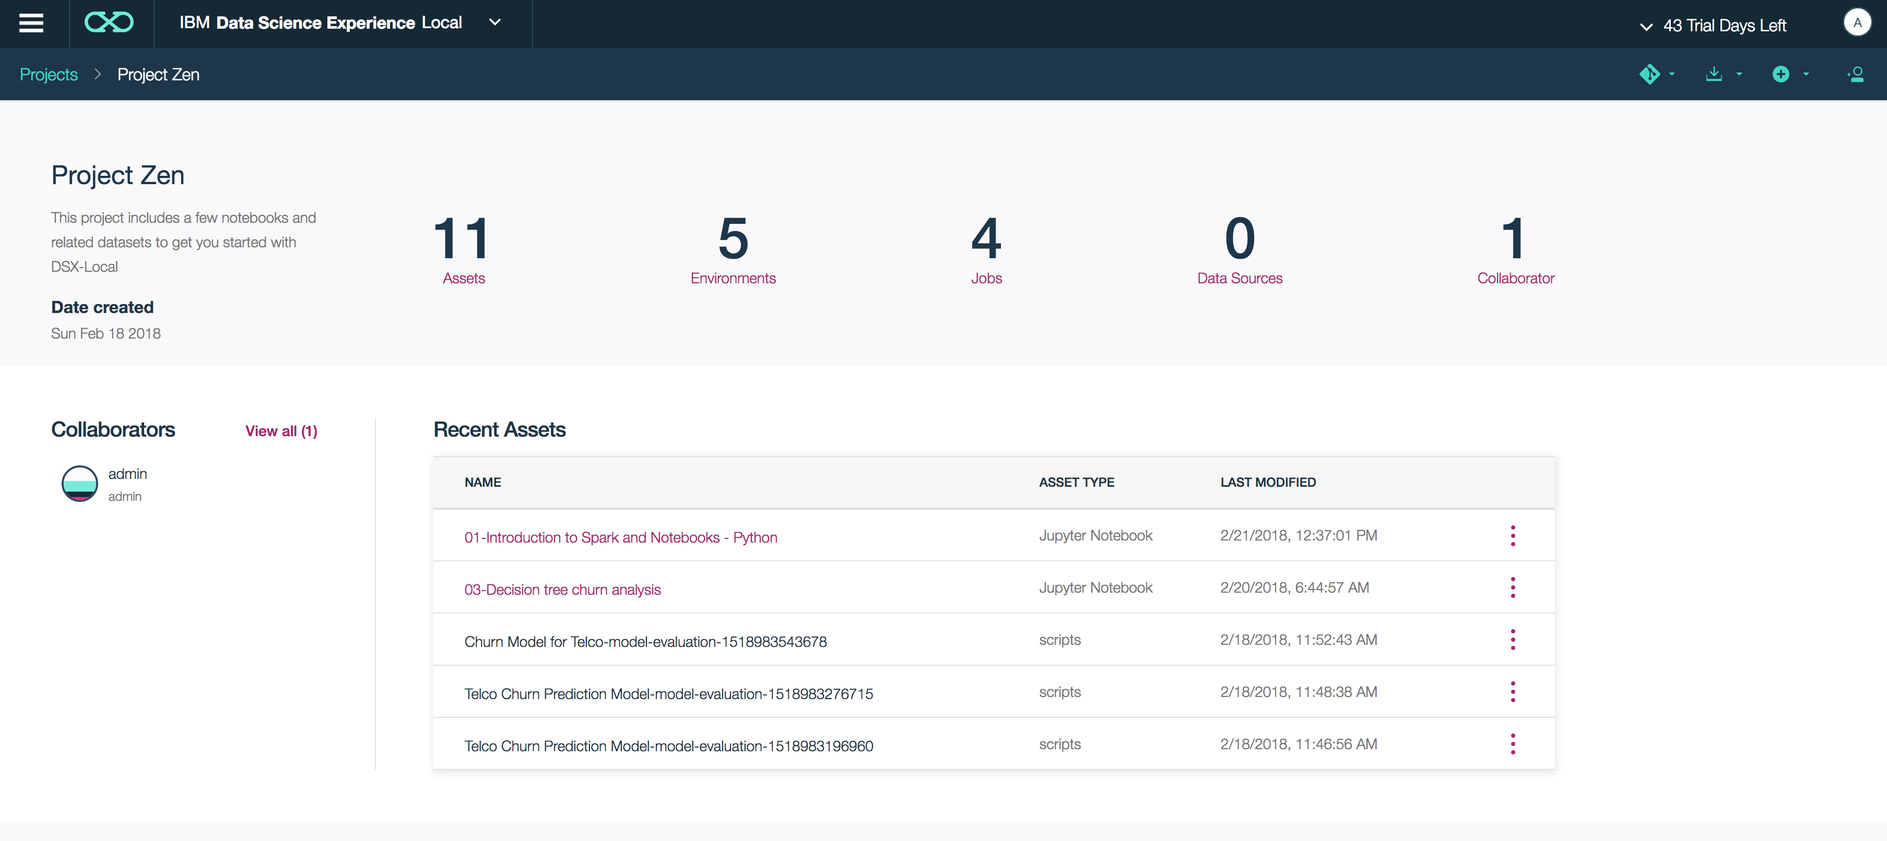

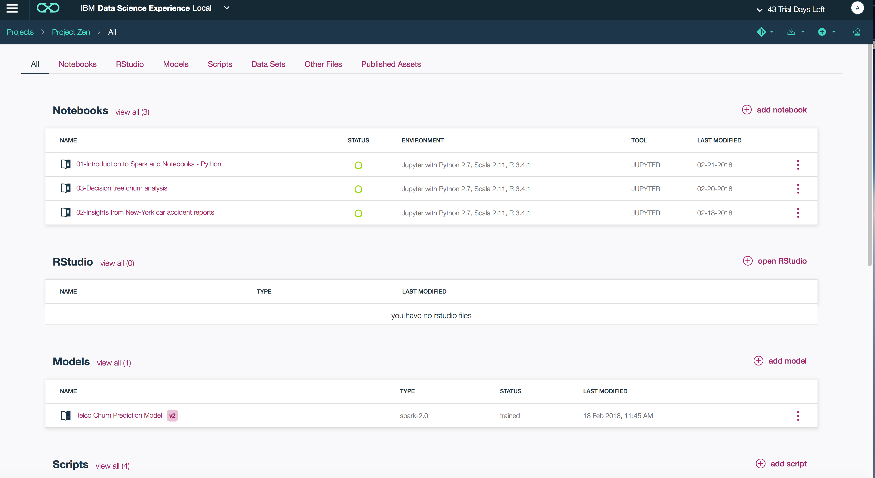
Data Science is a team sport
Collaborate within git-backed projects

Slide 10
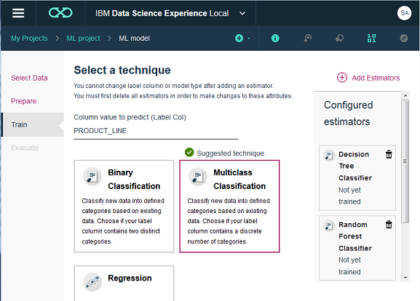
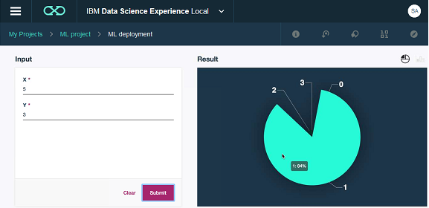
Build & Collaborate
Facilitate creation of machine learning models
Facilitate deployment of models as API end-points
Automation of Batch Scoring, Training and Evaluation scripts as schedulable jobs
GIT integration to collaborate with engineers in their favorite environment
Publish content to others in pdf / html / R-Shiny app

Slide 11
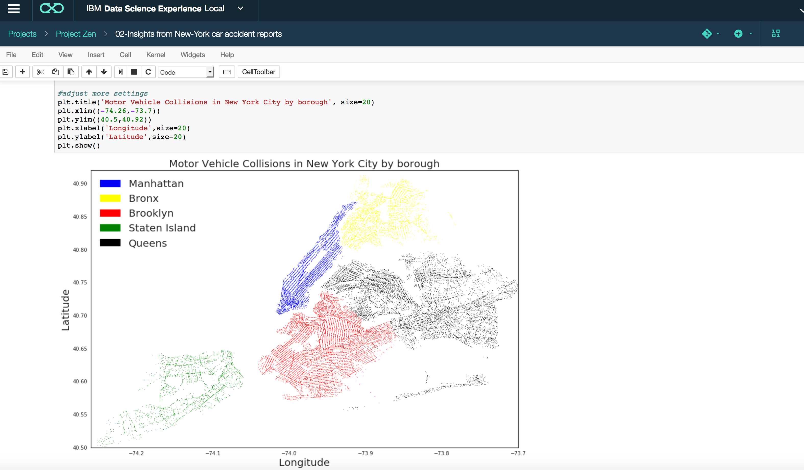
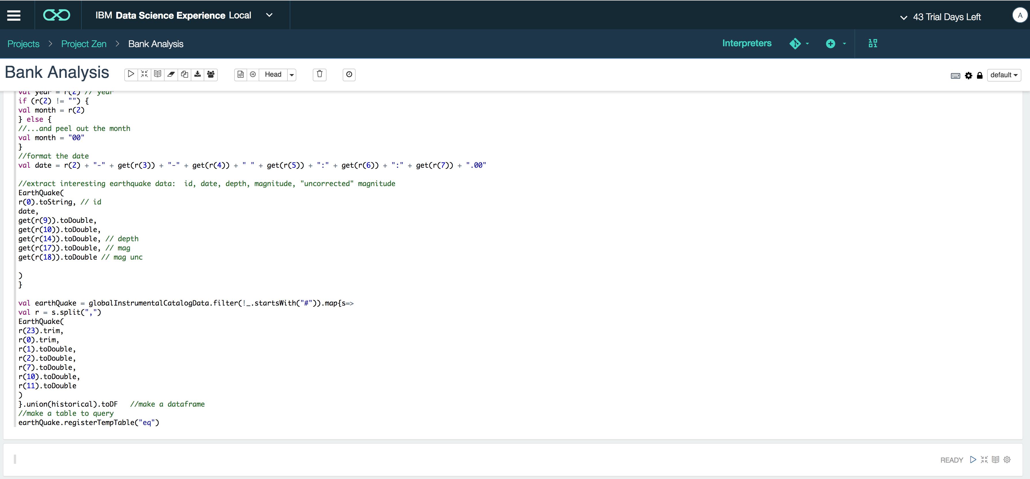
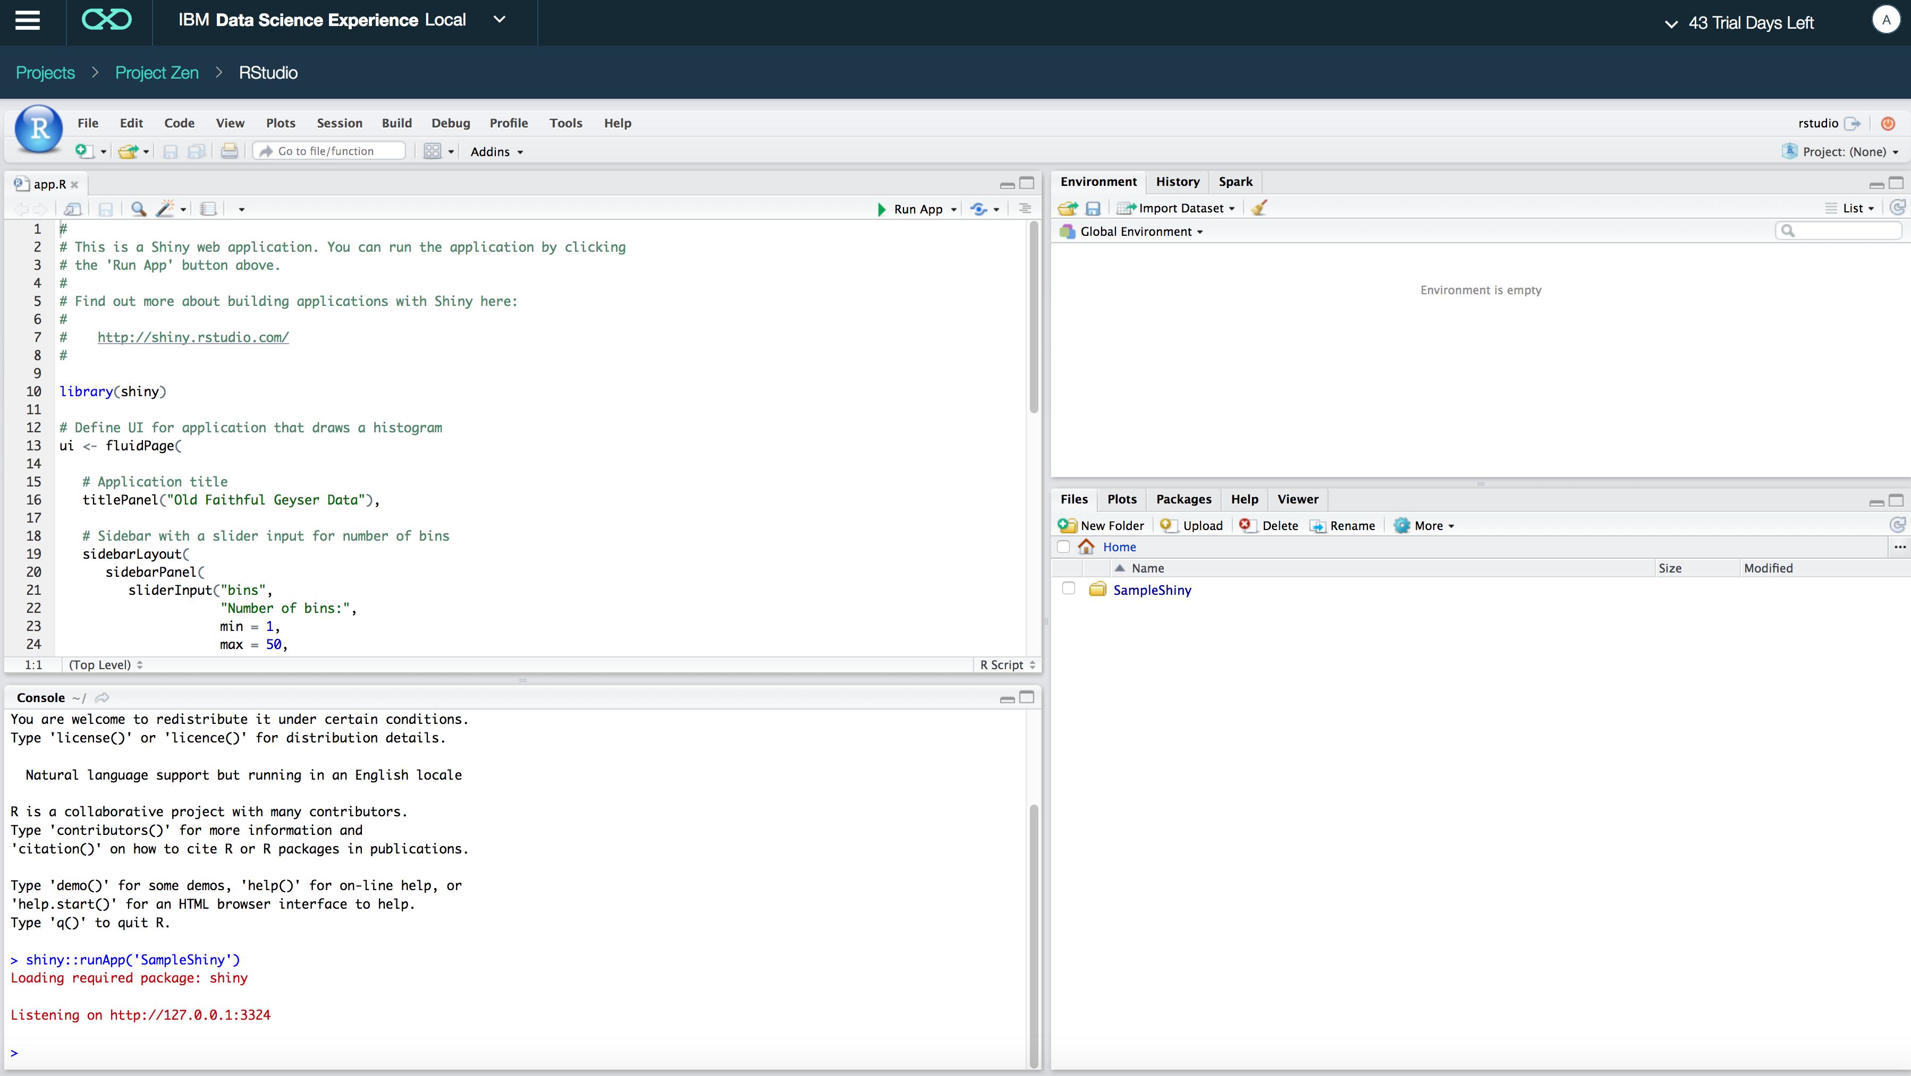
Essential tools for Data Scientists
Jupyter notebook Environment
Python 2.7/3.5 with Anaconda
Scala, R
Zeppelin notebook
with Python 2.7 with Anaconda
R Studio Environment with > 300 packages, R Markdown, R Shiny

Slide 12
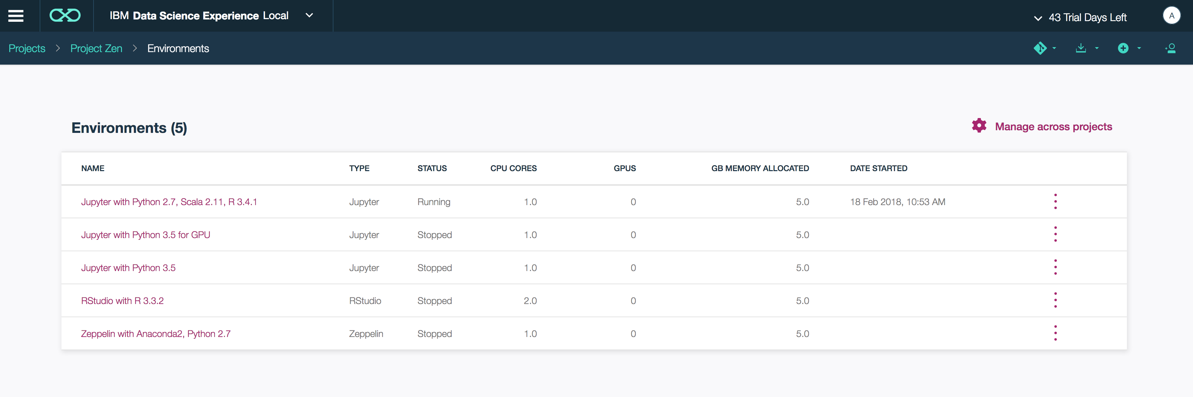
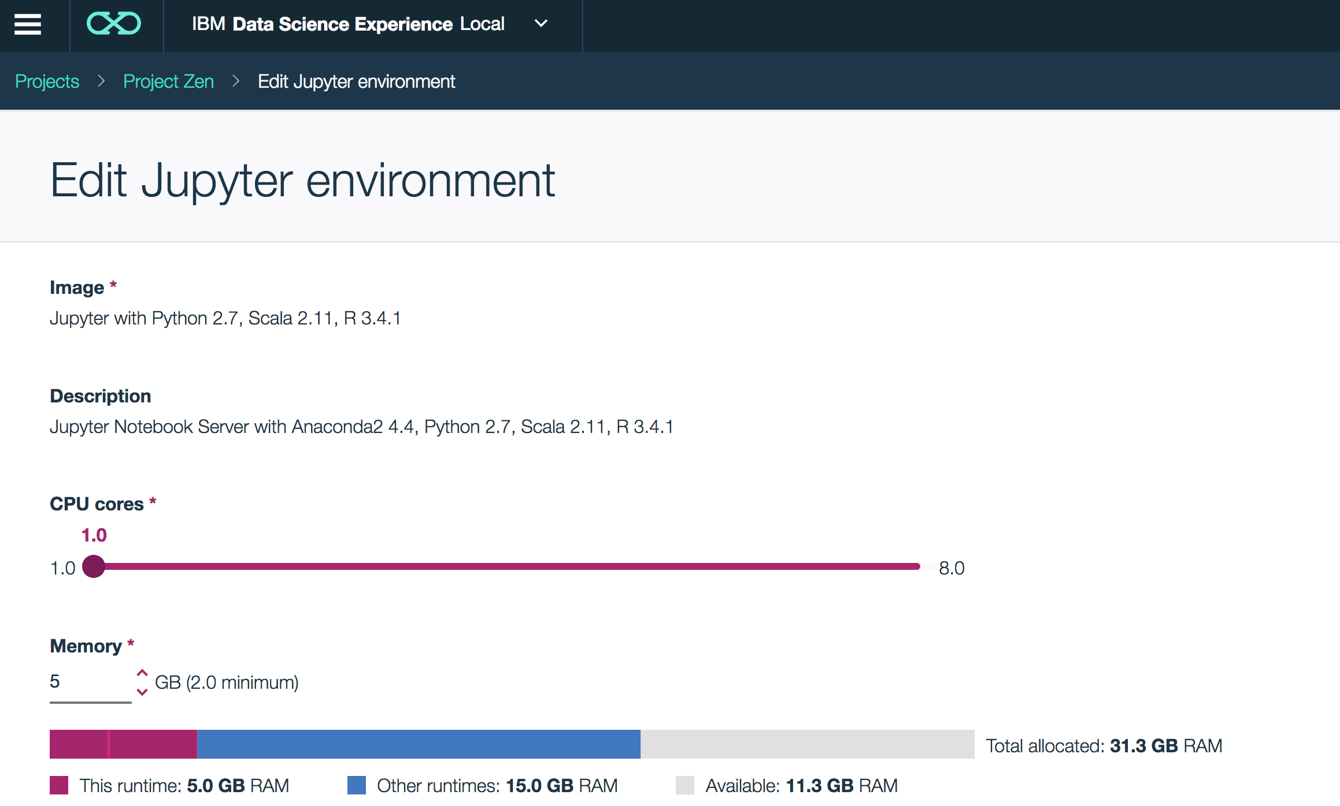
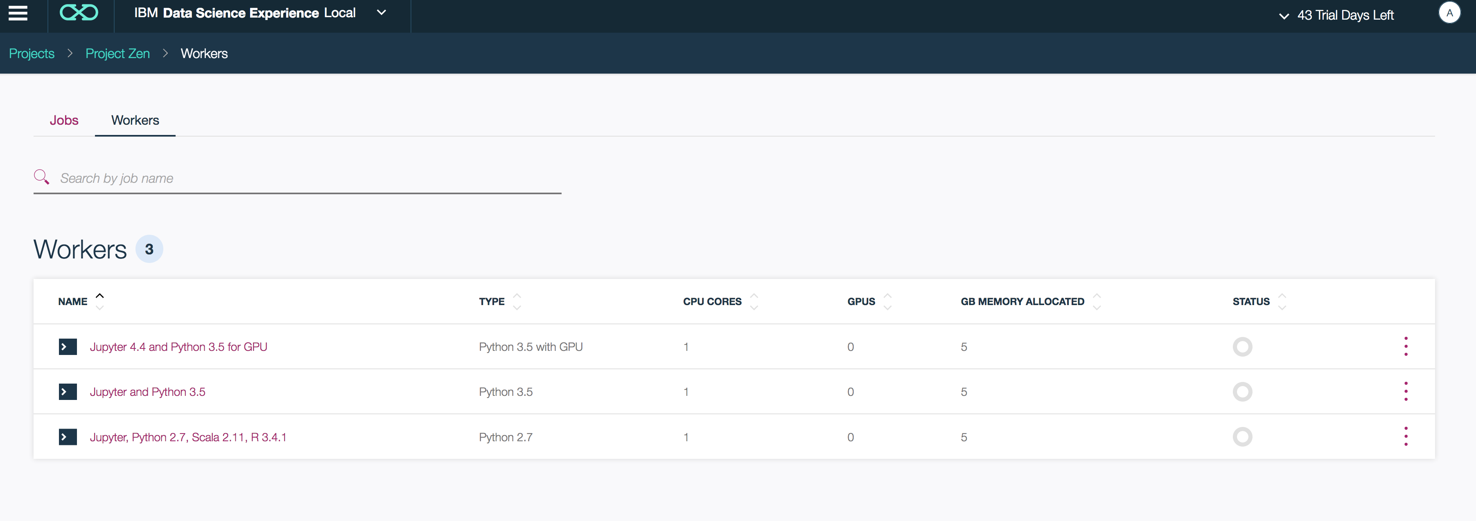
Self serve Compute Environments
Servers/IDEs - lifecyle easily controlled by each Data Scientist
Self-serve reservations of compute resources
Worker compute resources – for batch jobs run on-demand or on schedule
Environments are essentially Kubernetes pods – with High Availability & Compute scale-out baked in
(load-balancing/auto-scaling is being planned for a future spring)

Slide 13
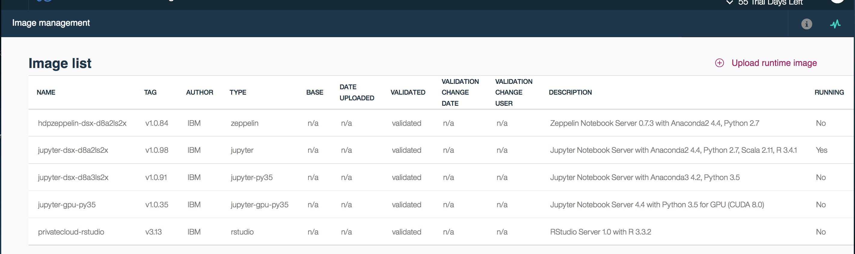
Extend .. – Roll your own Environments
Add libs/packages to the existing Jupyter, Rstudio , Zeppelin IDE Environments or introduce new Job “Worker” environments
https://content-dsxlocal.mybluemix.net/docs/content/local/images.html
DSX Local provides a Docker Registry (and replicated for HA) as well.
These images get managed by DSX and is used to help build out custom Environments

Slide 14
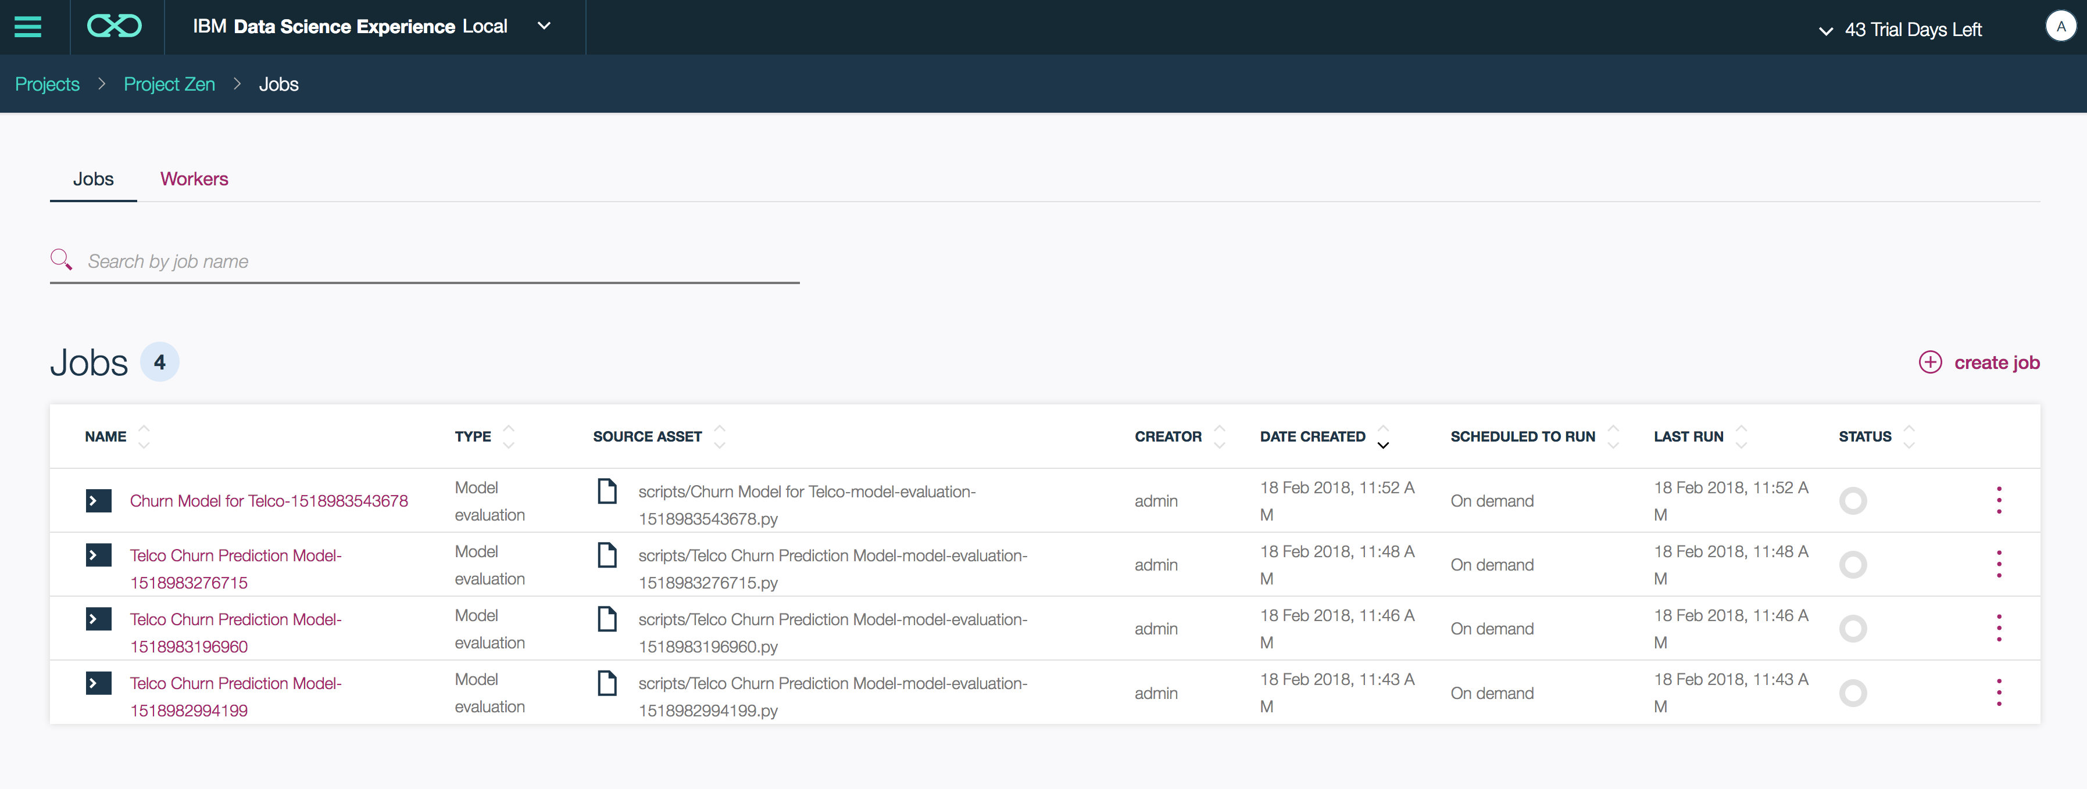
Automate ..
Jobs – trigger on-demand or by a schedule.
such as for Model Evaluations, Batch scoring or even continuous (re-) training

Slide 15
DSXL Labs
https://ec2-54-88-58-154.compute-1.amazonaws.com
user01 - user20 / IBMdsxl!
https://github.com/jpatter/DSX_Local_Workshop_V12/

Slide 16
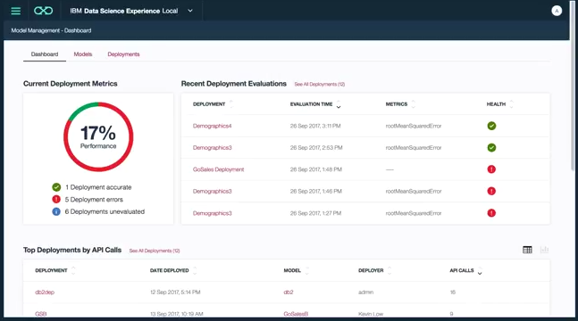
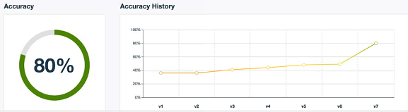
Deploy, monitor and manage
Monitor models through a dashboard
Model versioning, evaluation history
Publish versions of models, supporting dev/stage/production paradigm
Monitor scalability through cluster dashboard
Adapt scalability by redistributing compute/memory/disk resources

Slide 17
What’s new in v1.2.0
“MMD” – Deployment Manager
Hadoop Integration Service
SPSS Modeler (Officially GA) - as an add-on
Decision Optimization community edition pre-packaged – full version as an add-on
Data Refinery (Beta)
Python & R Script Editor
R Machine Learning models support
Projects: Tagging, Commit History, BitBucket support, Enhanced Tree view
Jobs Enhancement: Run SPSS Modeler Flows, Stop/Cancel running jobs
Custom JDBC driver: to connect to generic JDBC capable sources
Improved administration experience: adding jdbc drivers, key & certificate tasks, setup Livy end-points, manage Hadoop Integration Service end-points

Slide 18
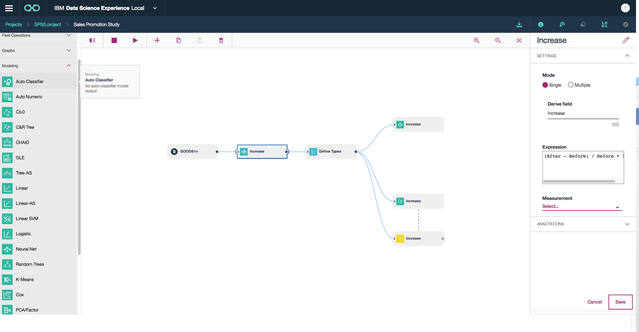
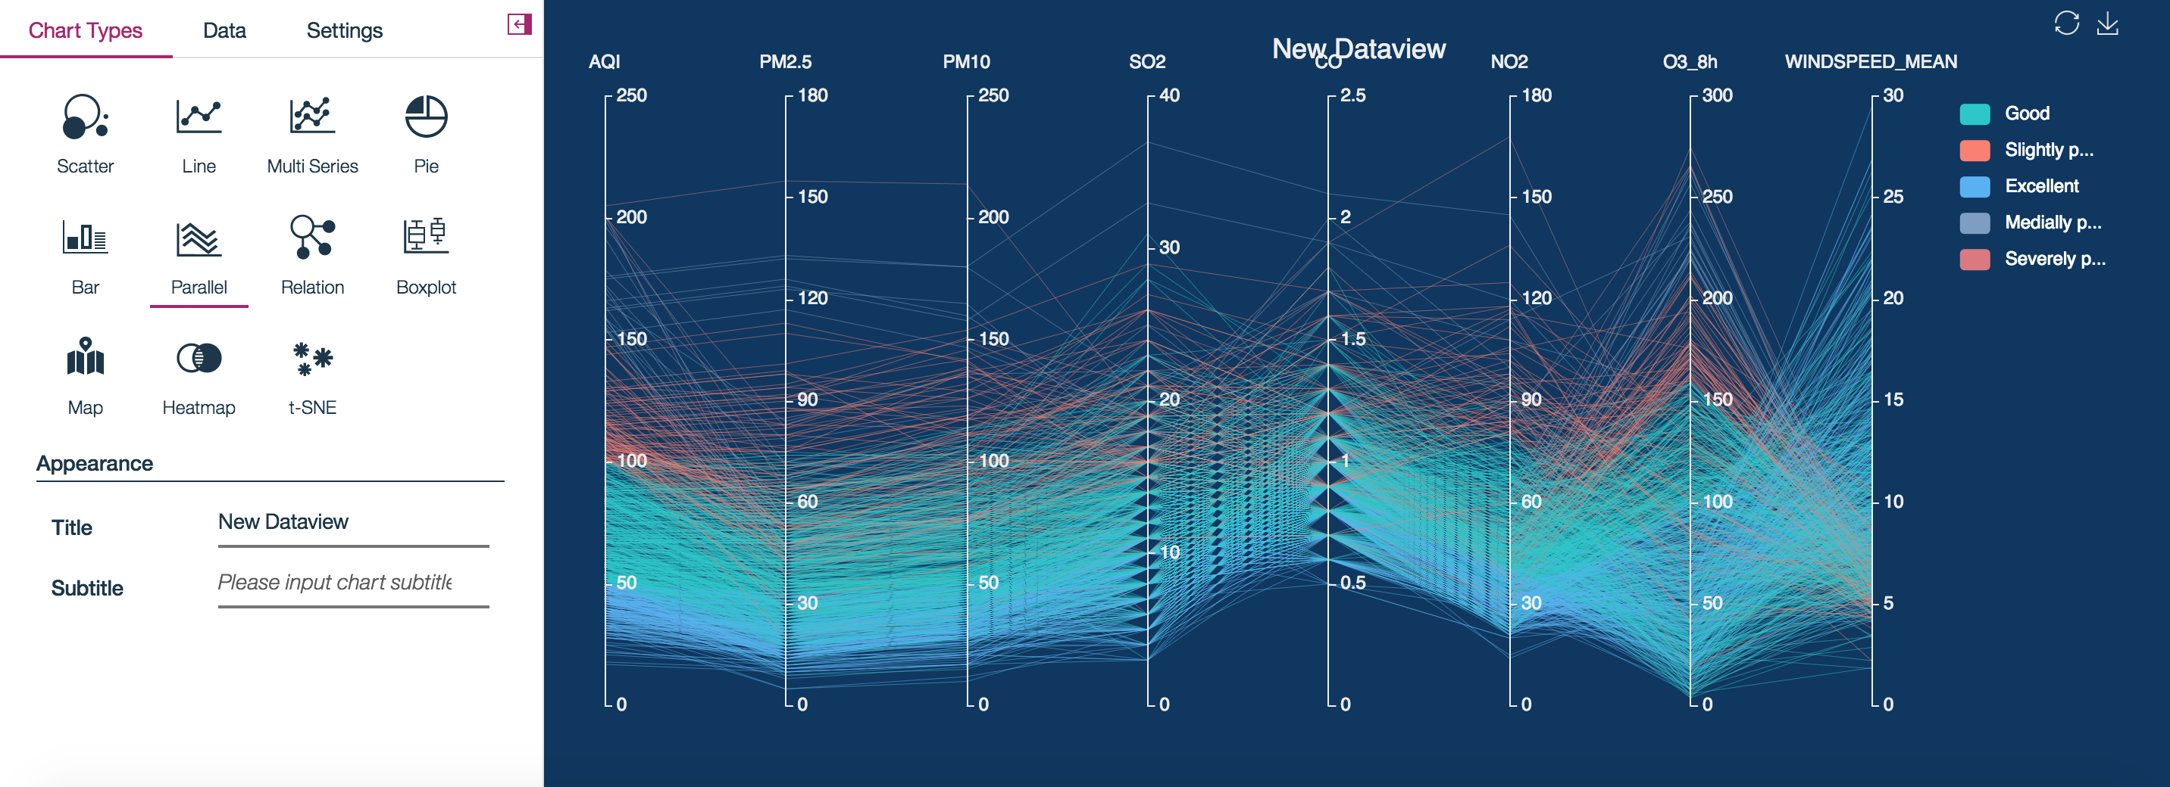
SPSS Modeler for DSX
Pain Points:
Lack of skills around coding
Environment for quick prototyping/experimentation
Easy path to deployment from visual productivity
Value Proposition:
Visual productivity tool around data science
Quicker time to value
Inclusion of full-fledged data preparation and many machine learning algorithms
Features:
Newly rebuilt interface with improved navigation and ease of use
Totally new interactive visualization
Ability to deploy results in Model Management and Deployment

Slide 19
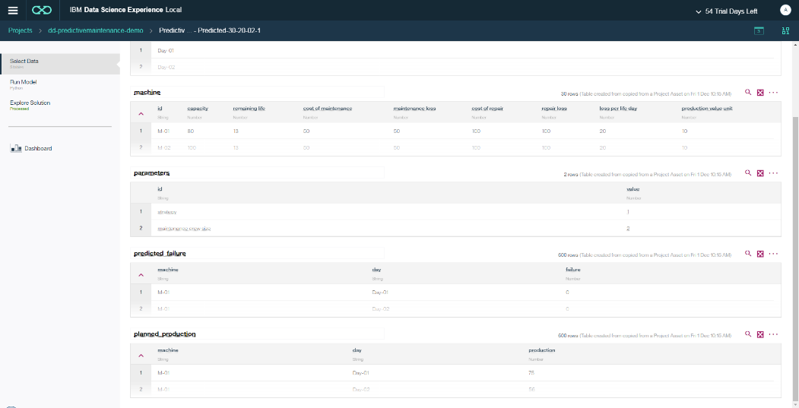
Decision Optimization for DSX
Pain Points:
Operationalize Data Science and drive higher ROI
One platform for predictive and prescriptive tools
Enable team on prescriptive tools and approaches
Productivity of expensive resources
Value Proposition:
Transform insights from ML into actions using DO
Add-on to DSX local with a mix of predictive and prescriptive in unified environment
Community cards, tutorials, etc.
Validate models using dashboards and execute what-if
Features:
Model building workflow
What-if analysis and dashboards
Beta: Modeling assistant (limited domains)

Slide 20
MMD: Introducing Manage Deployments feature
Supports Dev->Test->Staging->Production CICD paradigm
Access control & Separation of duties
Enables a clear path for promotion of assets to production, while enabling Development to continue on separately.
Dev: (DSX Local Projects)
Build & test out assets
Notebooks
Python & R Scripts
Run as a Job in DSXL cluster or against the Hadoop Integration Service
REST based tests against User authored Scripts run as a Web Service
(invoke Python or R functions – for example for Custom “Scorers”, to infuse custom data prep)
Models – Train & Test from scripts/notebooks
Shiny Apps – Build & Preview
SPSS Modeler Flows - Design & Test
A Project “Release” Tag
identifies a stable checkpoint in the history of the Project that marks its (possible) promotion to Production
implemented as a git tag (also applies to github/bitbucket repositories or exported project .zip/.tar.gz archives)

Slide 21
MMD: Introducing Manage Deployments feature
Production with “MMD”: either in the same cluster as Dev or use a separate cluster
Pull from the release git tag(or export/import)
Create deployments
Create online scoring end-points for Models (or versions of a model)
Schedule Batch Jobs such as SPSS Modeler Flows, Python/R scoring or evaluations, against Hadoop etc.
Schedule execution & externalize Jupyter Notebooks
Externalize Shiny Apps
Expose User authored Scripts as a Web Service
API based access to Python or R functions –such as Custom Scorers with custom data prep
Define resource requirements & SLAs for Deployments
Per deployment – choose to “reserve” compute (or acquire when needed)
Load balancing and latency - choose to run replicas of Scoring servers, Scripts-as-Web Services for high throughput needs
Variations:
Export a “Deployment Manifest” from a “Staging” MMD and Import - modify in a Production MMD
Use the same MMD instance for both staging and production – just create two “Project Releases” with different URL routes.

Slide 22
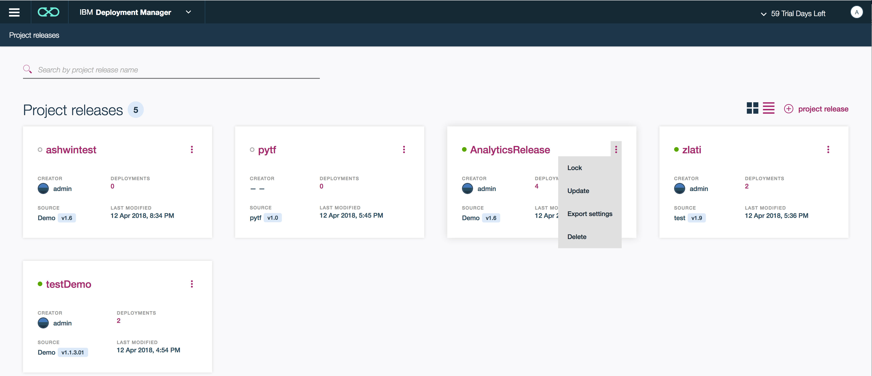
Deployment manager - Project Releases
Current git tag
Project releases
Deployed & (delta)updatable

Slide 23
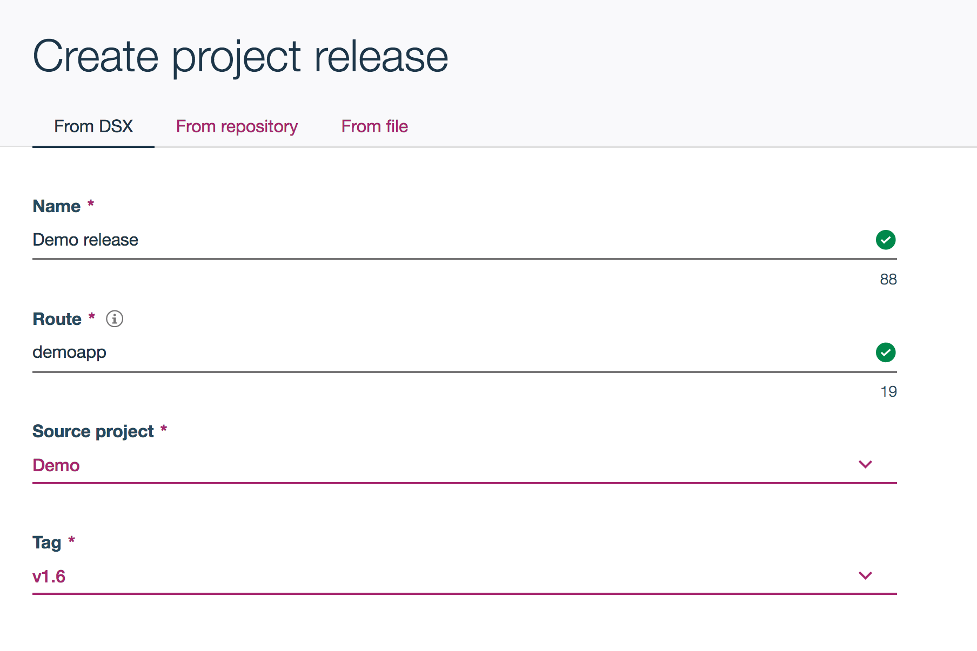
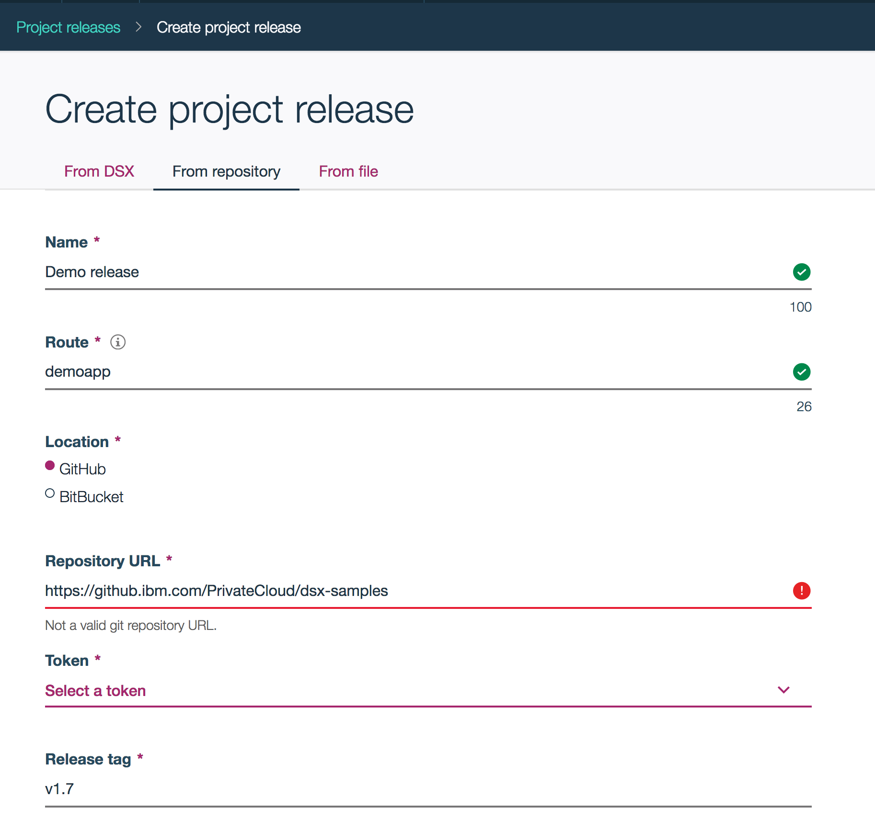
Bring in a new “release” to production
New Releases
- from a “Source” Project created from a .tar.gz package
New Releases
- from a “Source” Project pulled from github/bitbucket
New Releases
- from a “Source” Project in the same cluster

Slide 24
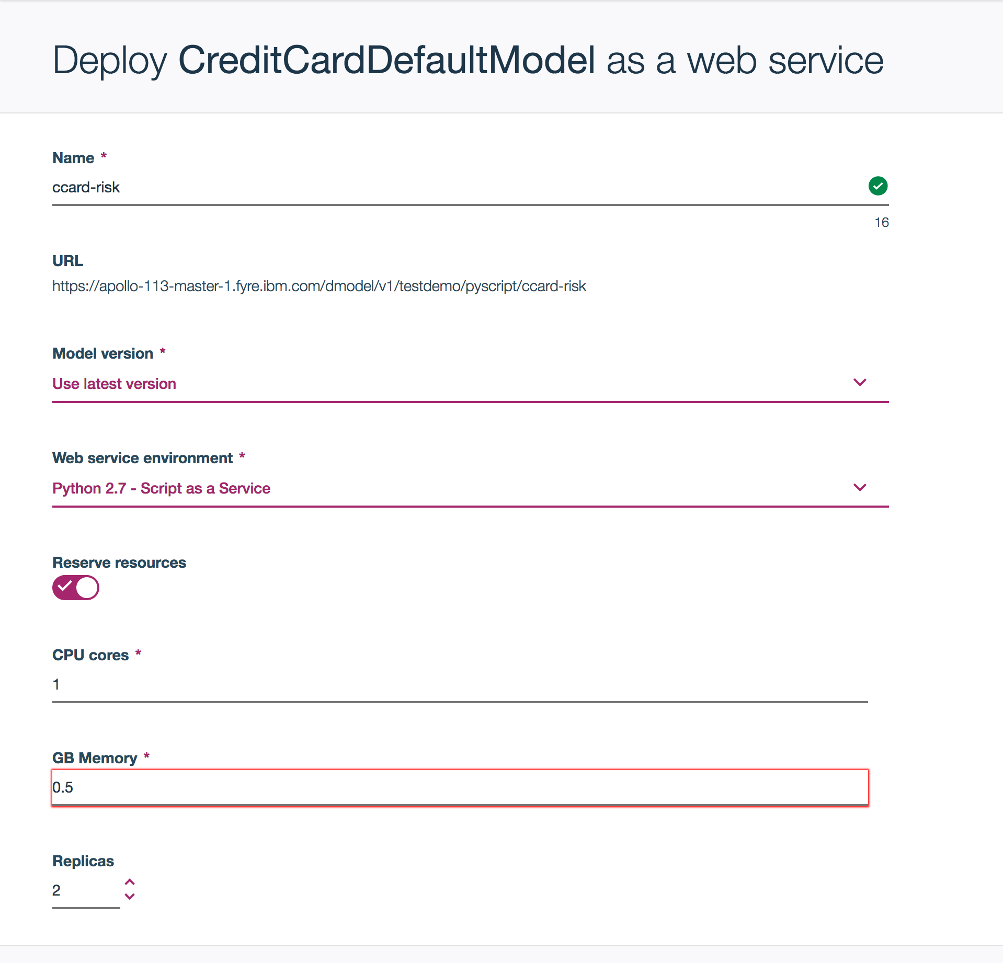
Expose a ML model via a REST API
scoring end-point
Model pre-loaded into memory
inside scoring containers
pick a version to expose
(multiple deployments are possible too..)
replicas for load balancing
Optionally reserve compute

Slide 25
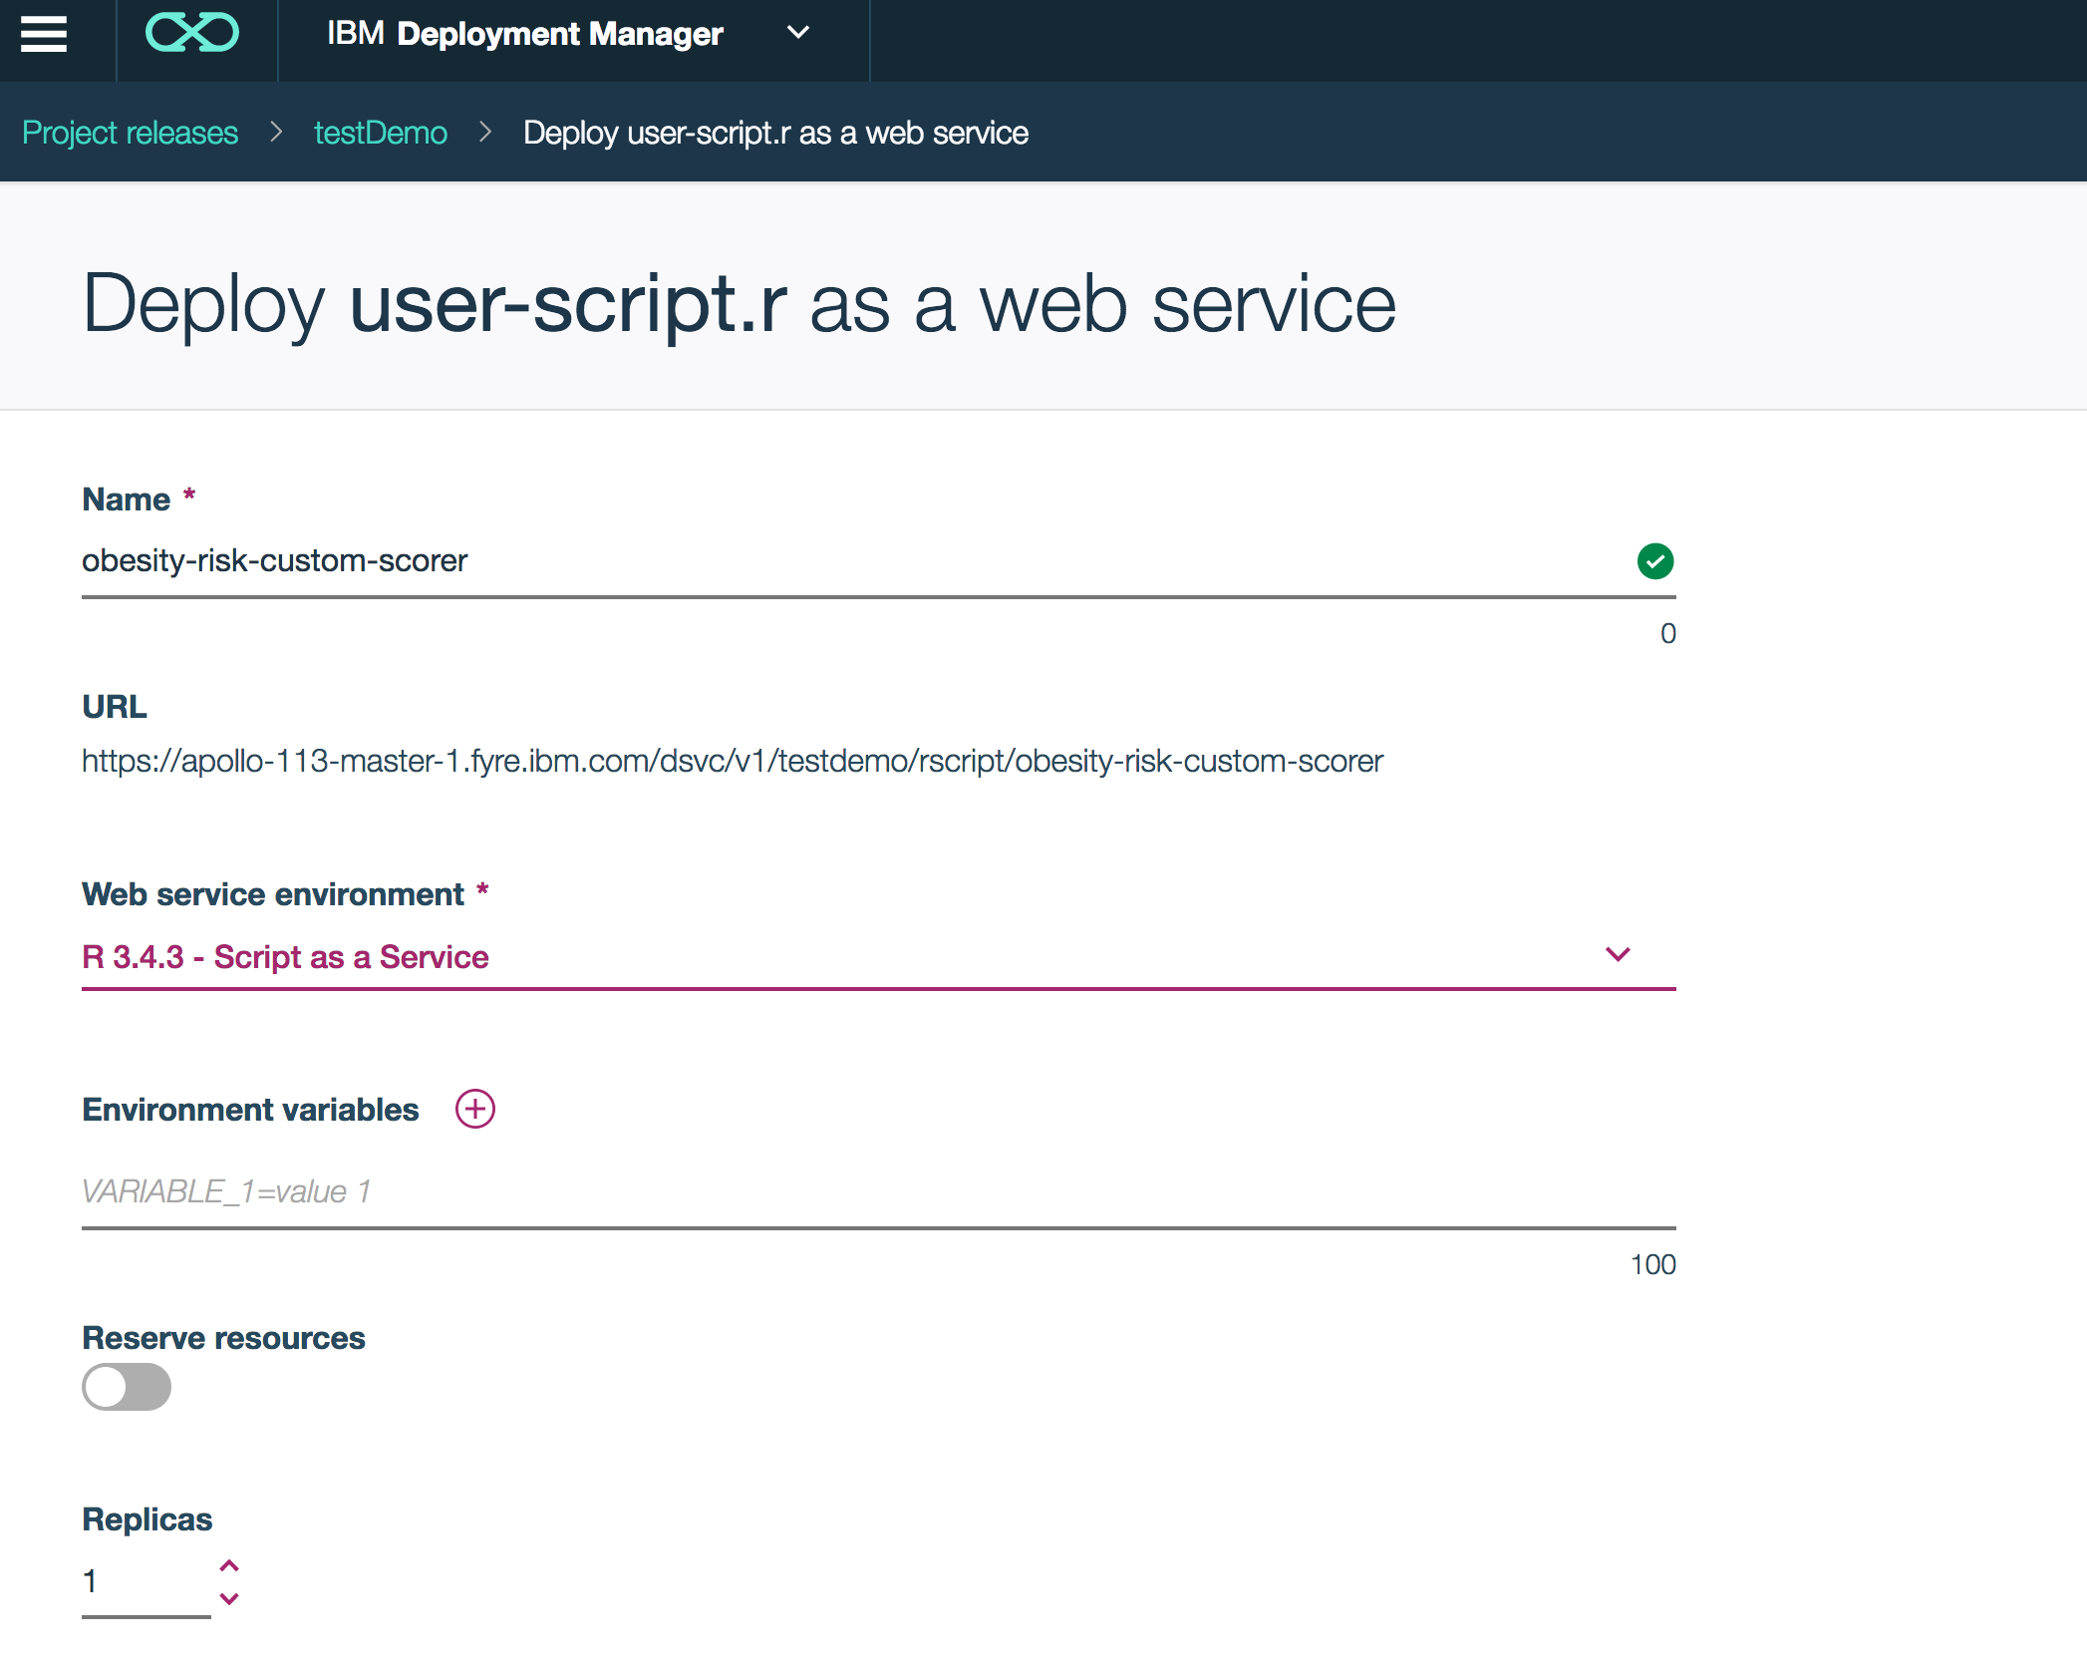
Expose Python and R scripts as a Web Service
Custom scripts can be externalized as a REST service
- say for custom prediction functions

Slide 26
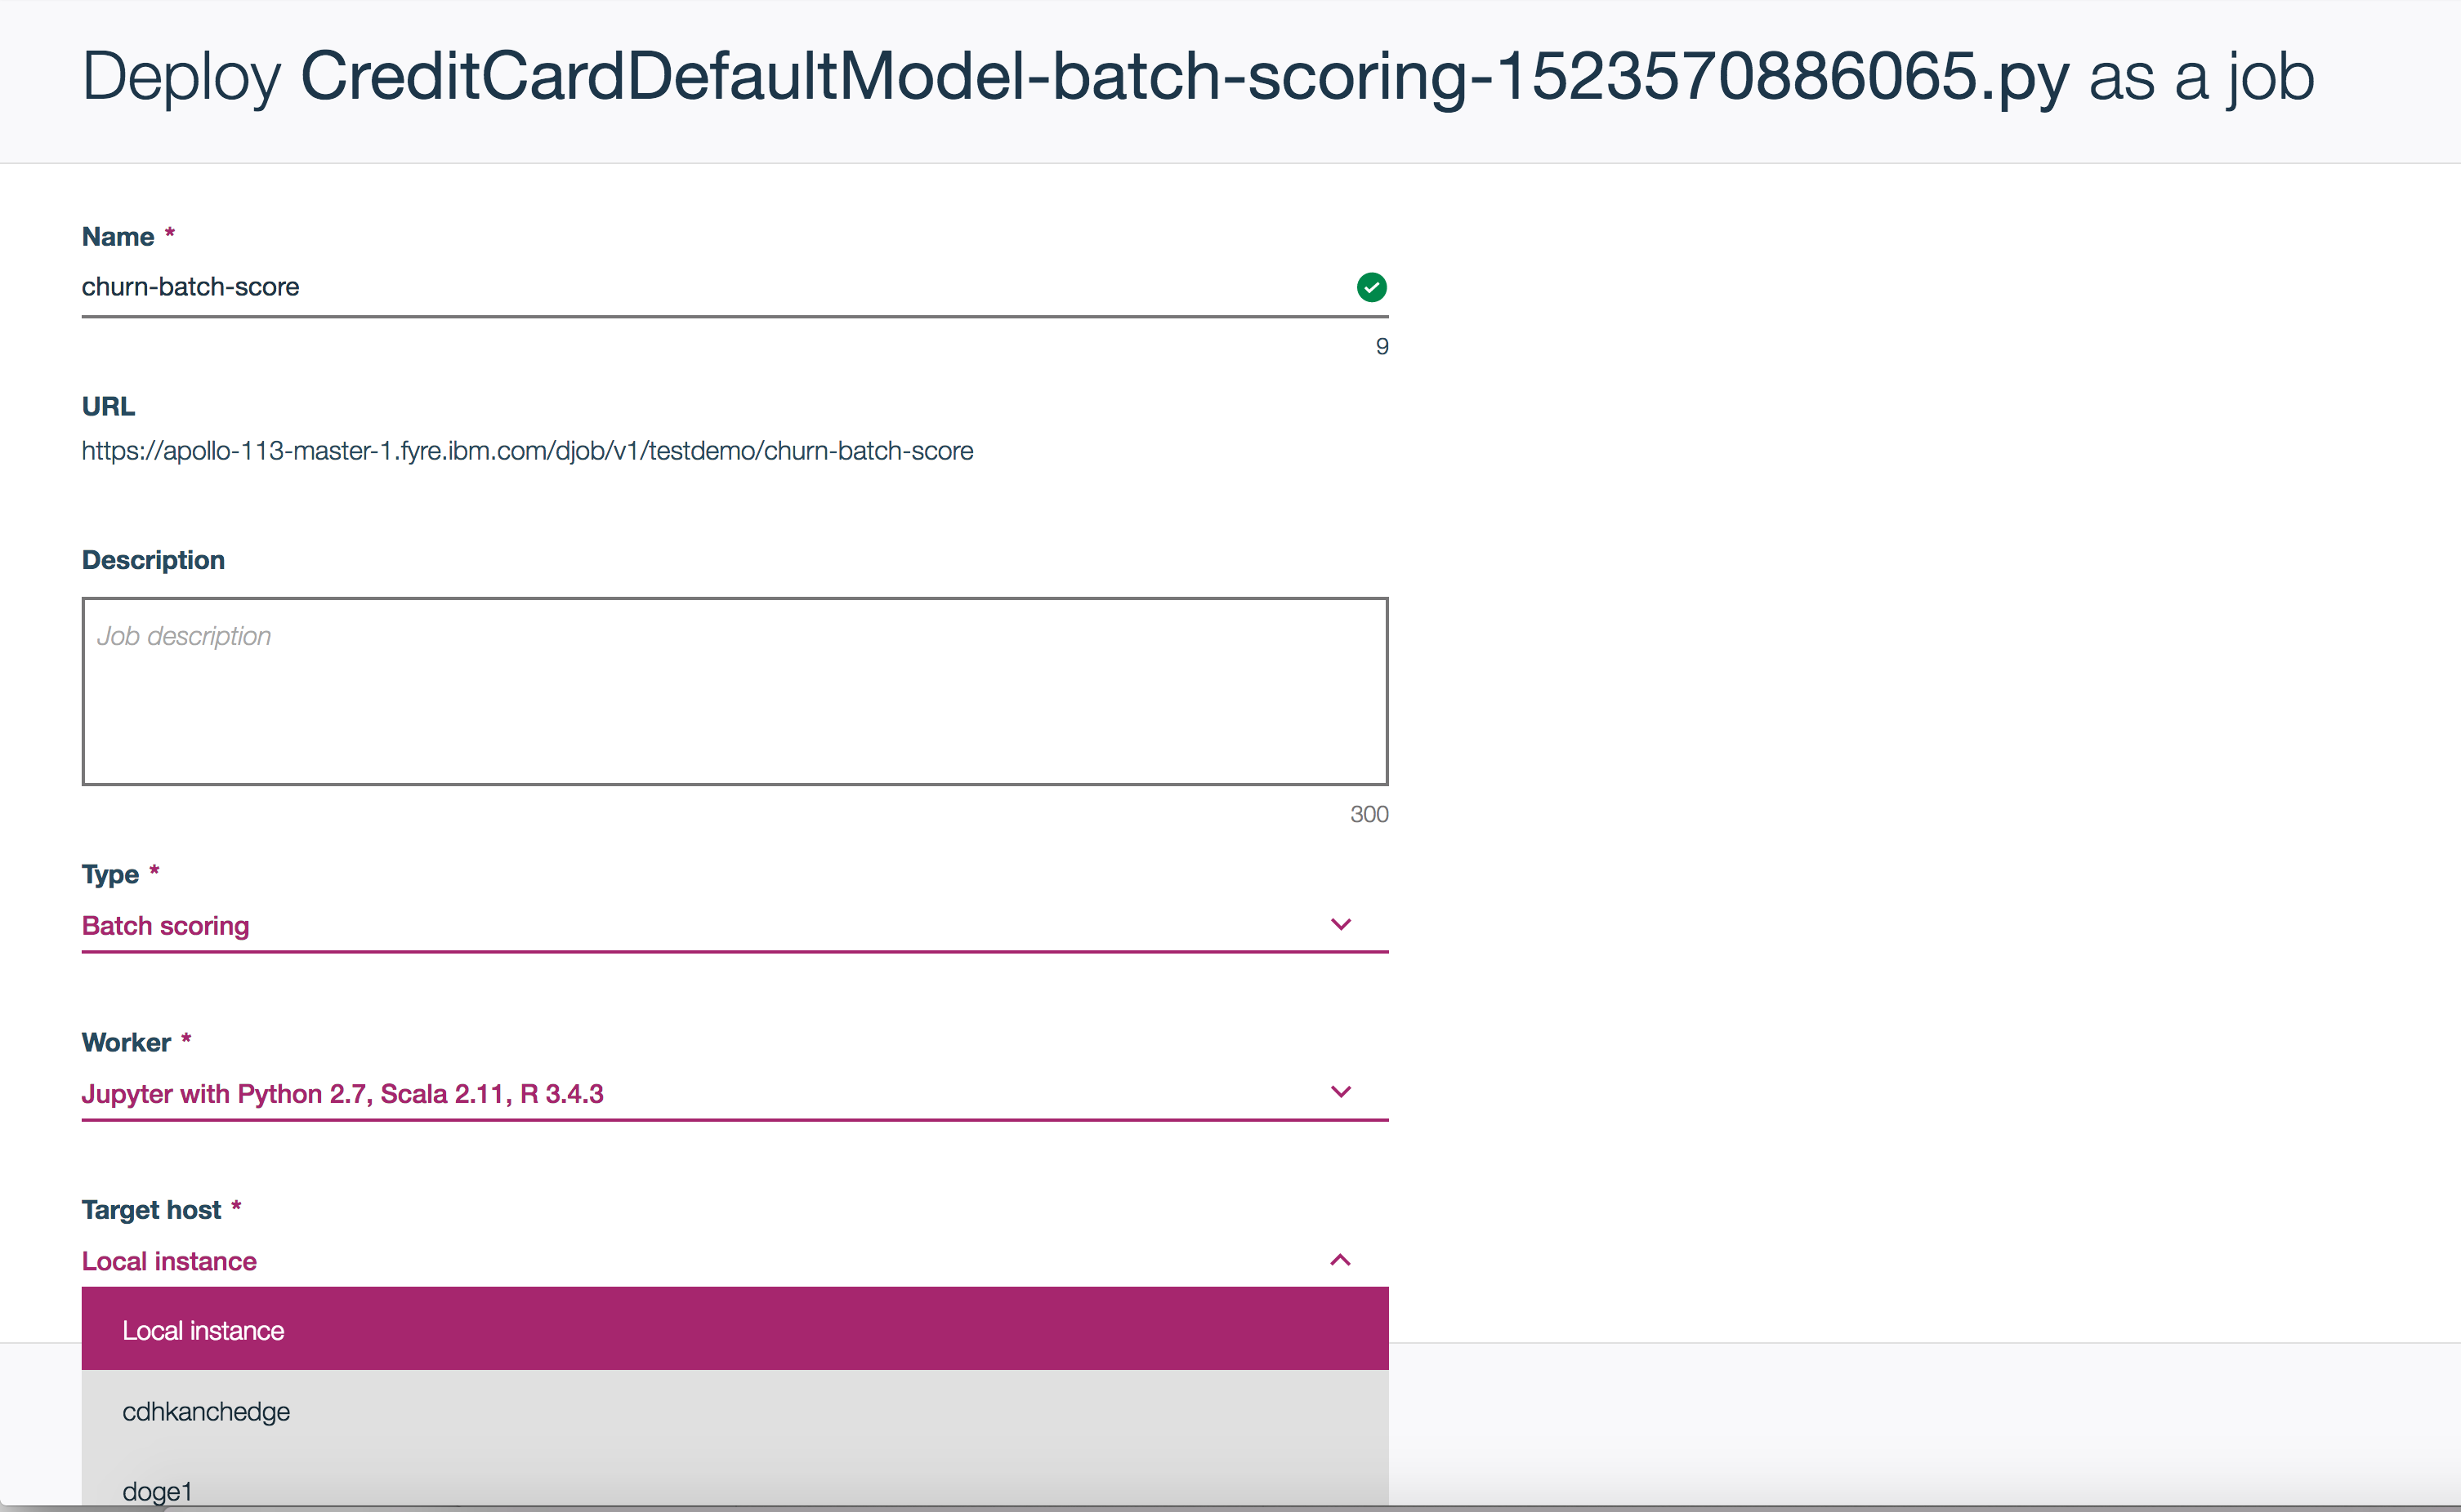
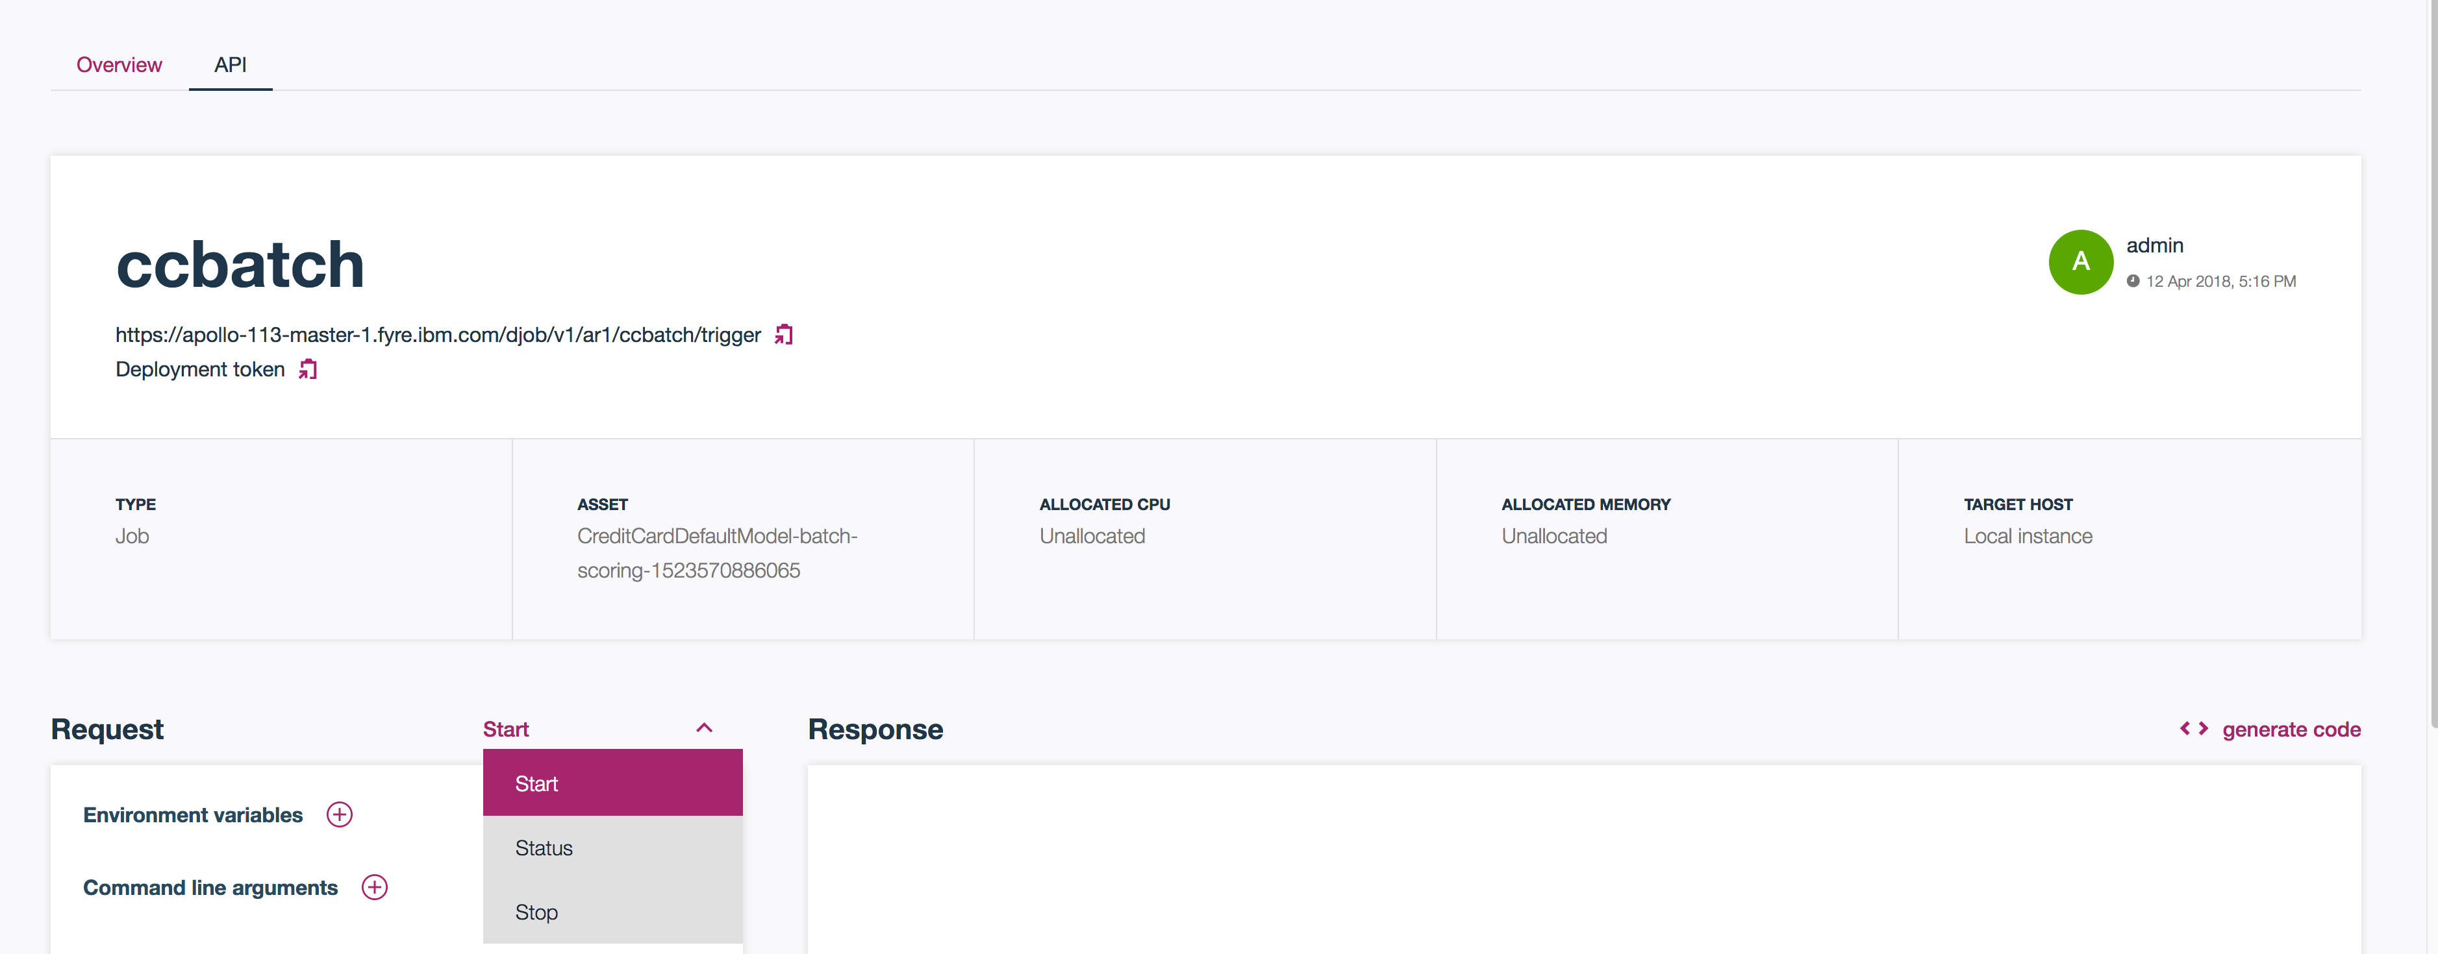
Deploy a script as a schedulable Job
Scripts can be deployed as a job..
URL exposed for the job for external triggering
And use the convenient API panel to understand how to invoke the job..
Can be run against a DSX Hadoop Integration Service environment

Slide 27
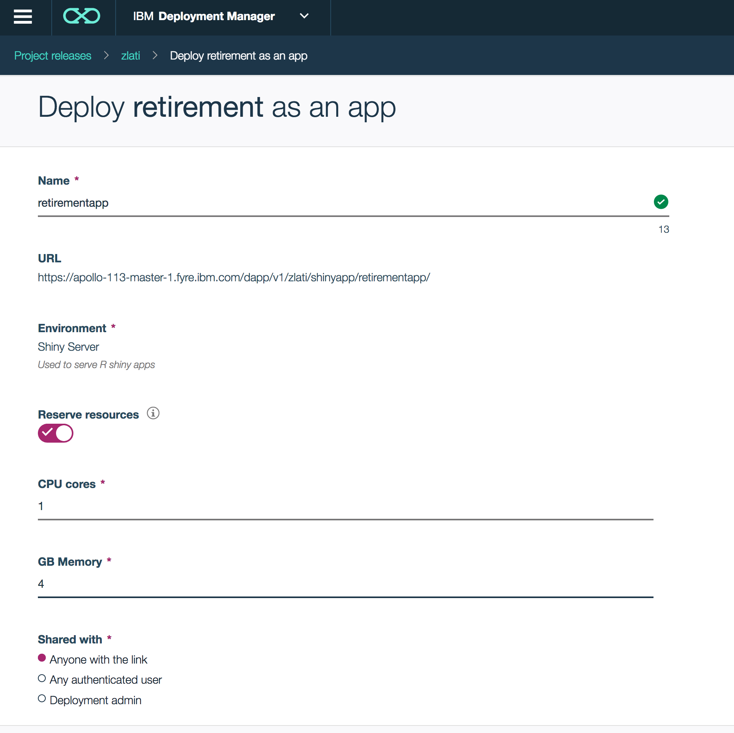
Deploy a Notebook or R Shiny App
Optionally reserve compute
Host a notebook or a Shiny App
Define visibility rules

Slide 28

DSX Local Architecture overview
Data Scientist –
web browser & API
LDAP/AD
(Authentication)
GitHub
& GitHub Enterprise
Spark
Cluster
(via Livy)
Relational Data Stores
Hadoop
(HDFS, Hive, IBM Big SQL)
Integrations & Connections
(projects & assets)
(DB2,Oracle, Teradata, etc.)
DSX Hadoop Integration Service
Customer
Systems
DSX Local Cluster
Core Services
Data Scientist Dev environment
Model Mgmt & Deployment
+ operations
Storage
Management
Services
Platform Control
& Management
Project services, Data Sources & .git
Jupyter
^{(anaconda-python, scala, R)}
^{Tensorflow-GPU}
Data Refinery
R.Shiny
^{apps}
Custom Scorers
Kubernetes Persistent Volumes
Admin interfaces
Batch
Scoring
Redis
^{(session store)}
User Management
^{& tokens}
RStudio
(and Shiny Apps)
SPSS Modeler
^{(add-on)}
Kubernetes Cluster
Model
Evaluations
Jupyter
^{notebook apps}
Scorers
registry vol
^{(dockeri mages)}
Metering
Monitoring
Spark, Spark-ML
Zeppelin
Decision Opt/CPLEX
^{(add-on)}
Package & Image mgmt
Jobs & Scheduling
Hosted Apps
Webservices
^{(Python,R})
Shared user volume
csv files,
projects,
models
Kubernetes
Master Components
Scripts (.py, .R) & Jobs
H20 Flows
^{(add-on)}
Environments: Resource mgmt
& Jobs
Projects, Publish & collaborations
Project Releases: Deployment/Scale-out load balancing & Monitoring
Cloudant
^{(metadata)}
Start with 3 nodes with HA enabled
Expand as needed
Kubernetes cluster spread across multiple servers

Slide 29
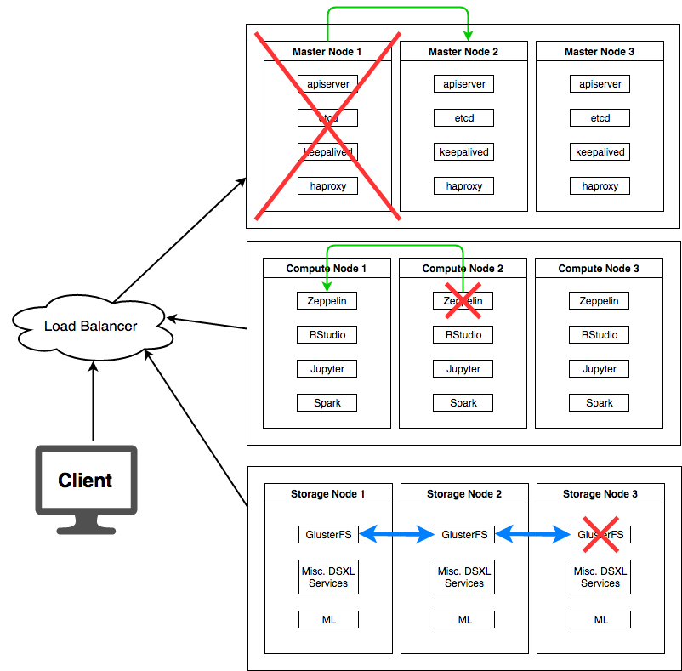
HA in DSX
Platform HA
By default, the cluster is configured for HA: minimum 3-node
Can tolerate failure of
1 node in a 3-node configuration
4 nodes in a 9-node configuration
Service HA
For services that are deployed as pods, Kubernetes will monitor and redeploy
No session failover, which means that some services may be down for a few minutes

Slide 30
Roadmap Highlights

Slide 31
Strategy Highlights
Jan 2018 (Delivered)
Mar 2018 (Delivered)
Q2 2018
2h 2018
New data connections to ease data access
Support for IBM BigSQL on HDP as a data source
Support for Cloudera data sources
Enhanced ML capabilities
Train, Deploy and Monitor Scikit-learn, xgboost, Tensorflow+Keras and spark-ml models
Automation - Batch Scoring and Evaluation scripts as schedulable jobs
Model versioning and evaluation history
Publish models
New Deep Learning and GPU support
Runtime Environments can now be associated with GPU(s)
Train Tensorflow+Keras models or execute other jobs that need GPUs in these Environments.
Collaborate
Publish and share the URL to any content (pdf, html, csv etc.) with other users
IBM SPSS Modeler
Refreshed GUI
High priority nodes
Decision Optimization for Data Science integration
Model Management and Deployment package
Deploy/Manage model versions
Deploy SPSS Modeler Streams + batch scoring
Deploy Notebooks, Scripts & Shiny Apps
Add support for R based Models
Management access control
Hadoop
Python, R job push-down to Yarn in a secure Hadoop cluster (in-addition to Livy-Spark)
SPSS Modeler enhancements
Additional nodes available
Extensions and scripting available with new GUI
Model Management and Deployment enhancement
SPSS Modeler Streams – real-time scoring
A/B testing & experimentation
Scale-out Deployments - replicas & load-balancing(Scoring servers & Shiny Apps etc.)
Apache Atlas, IGC and Apache Ranger integration
Add-on/Extensions
- pick from a “market-place”, mix-n-map Environments easily
WEX integration - Text analytics – including support for ML annotators, classifiers, and custom annotators
HDP/Yarn 3.1’ s Kubernetes native support provides for Data Plane and DSX running directly on HDP-Kubernetes
Enable partner and third-party tool integrations
Support DL frameworks/libraries: DL4J, Caffe2, CNTK with GPU support.

Slide 32




Key scenario: Governed Enterprise Data Science
Exec
Data Engineer
Development
& prototyping
Sets goals &
measures results
Collects
Builds data lakes
and warehouses
Gets Data Ready for Analytics
Problem Statement or target opportunity
Finds Data
(from an enterprise catalog)
Production
App. Developer
Infuses ML in apps & processes
Predictions
Explores & Understands Data
Real-time Apps
& business processes
Data Scientist
Refine
PRODUCTION
Secure & Governed
Monitor & Instrument
High Throughput
-Load Balance & Scale
Reliable Deployments
- outage free upgrades
Collects, Preps & Persists Data
CDO (Data Steward)
Deploys & monitors accuracy
Auto-retrain
Analyzes
Explores, Shapes data
& trains models
Trains Model
Extracts features for ML
Organizes
Data & Analytics Asset Enterprise Catalog
Lineage
Governance of Data & Models
Audits & Policies
Features, Lineage/Relationships recorded
in Governance Catalog
Experiments

Slide 33
Goal: Enterprise IaaS for Data Scientists
Efficient Compute Resource Management for large-scale Analytics, Machine Learning and Deep Learning workloads
Enable Data Scientists to procure resources from a shared compute “grid” for any kind of activity – from interactive notebooks & IDEs to training Jobs or scheduled scripts and Apps.
All compute manifested as Docker containers/Kubernetes pods
HDP/Yarn as the Resource Manager
Enable all workloads, whether Map Reduce or Spark Jobs or DSX/ML activities to be uniformly handled by the HDP/Yarn scheduler.
Manage Queue Priorities, balancing of workloads and scale-out for the whole cluster providing best utilization of all resources.
Yarn and Kubernetes - the best of both worlds !

